Slide 1
Introducing China culture
Yurara, Koharu 11/7 intercultural communication

Slide 2
Overview
Introduction
Hofstede's Cultural Dimentions Overview
Interview Findings
Reflection
Conclusion

Slide 3

Introduction
About interviewee
Name: Tony
From: China
Major: Computer science
3rd student

Slide 4
Hofstede's Cultural Dimentions Overview
Power distance index(PDI)
Individualism & collectivism(IDV)
Masculinity & Femininity(MAS)
Uncertainty avoidance index(UAI)
Long-term & Short-term Orientation(LTO)
Notes:
1.Hierarchy
2. Defference way of thinking between "I" or "We"
3. Preference for success as well as gender roles
4. The way of thinking about "change“
5.Which you focus on future or present

Slide 5

Interview Findings
Power Distance Index
A: High Power distance.
Basically, in China the boss respects employee’s opinion, but someone is more respected.
Compared to Japan
Higher than Japan

Slide 6

Individualism & Collectivism
Collectivism.
Ex; Working with person has ability, we can success more easily.
Compared to Japan;
Same. Japanese education policy is cooperative

Slide 7
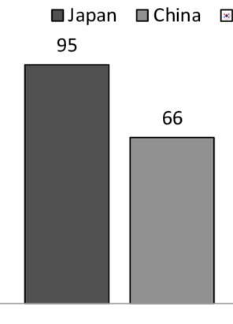
Masculinity& Femininity
MAS rate
Sum Masculinity
Ex. Hard working is important.
Compared to Japan;
MAS really related to success
Notes:
Thinking about why I mistook relate avoiding mistake next time

Slide 8
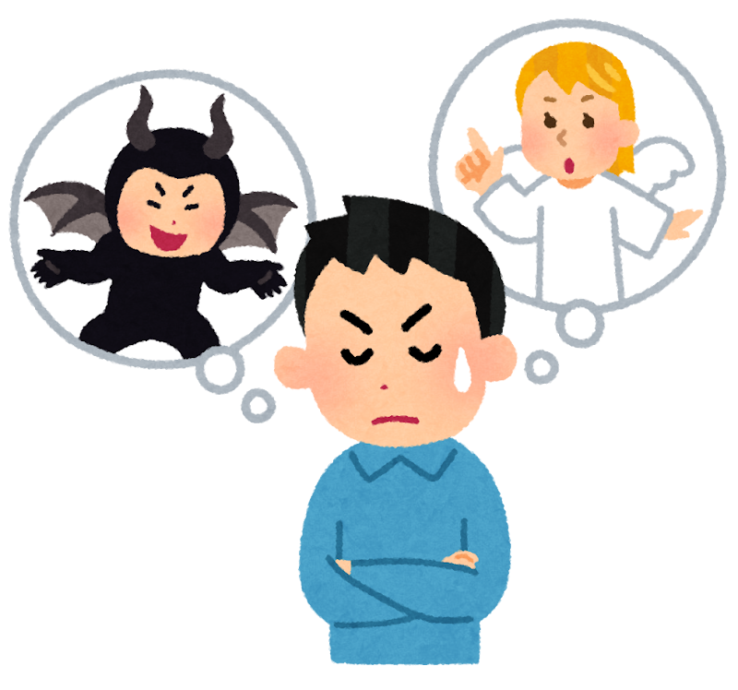
Bad Good
Uncertainty Avoidance Index
Q: Would you rather eat your favorite food every day or try something new?
A: Try something new.
Compared Japan: Lower than Japan

Slide 9

Long-Term &
Short-Term Orientation
Sum Long term
Ex. Invest and start new business to earn more money.
Compared to Japan;
Long-term. Permanent employment system related to way of thinking about future
Notes:
. Invest and start new business to earn more money.

Slide 10
Reflection

Slide 11
Conclusion
Key takeaways
Cultural dimensions is different.
Each nation has its own culture and values.
Understanding these differences helps us.
Final thought
Respect each culture for what makes it unique.
Diversity is what makes our world interesting and connected.
Notes:
3.7.8.10.12
Cultural dimensions differ from country to country.
Even within Asia, each nation has its own unique culture and values.
Understanding these differences helps us communicate and live together more effectively.
Respect each culture for what makes it unique.
Diversity is what makes our world interesting and connected.

Slide 12
Thank you for listening!!

